Slide 1

Wireless Power Transfer
C1C Pak
C1C Singh
C1C Henry
C1C Hermanson
1

Slide 2
Overview
Executive Summary
Technical Discussion
Motivation
Problem Statement
Related Work
Methodology
Results
Discussion
Future Work
Questions

Slide 3
Executive Summary
Review fundamentals of WPT and associated vulnerabilities.
Discussion of action items researched and completed throughout this Semester.
Review significant developments and existing challenges related to the research.
Consider the next phase of research and look ahead at long-term goals of this Capstone Project.
Consider the long-term implications of this capstone project.

Slide 4
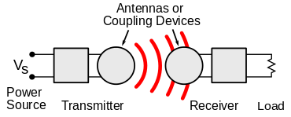
Technical Discussion
WPT is wireless point to point transmission of electrical energy
Many implementations but Qi is the industry standard
Alternatives: AirFuel, Proprietary Near Field Magnetic Coupling, RF, Ultrasound
Delivers a variable amount of voltage to device depending on power requirements (5-15 Watts)
New technology that lacks security capabilities and has vulnerabilities
Malicious messages can be sent between transmitter and receiver to alter power transmission
Messages between transmitter and receiver can be observed to gain information about receiver

Slide 5
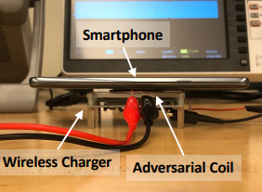
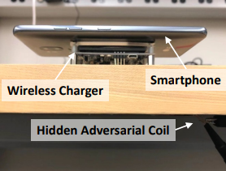
WPT Attack Vectors
Hijacking
Injection of adversarial magnetic signals on the power transmitter to hijack the communication channel
Disruption of magnetic field (via well crafted injection) between transmitter and receiver – cause inefficient power transfer
Control of power transfer process
Eavesdropping
Qi has lack of encryption and authentication mechanisms
Snoop communication between transmitter and receiver
Infer activity of receiver device
Q ID & C allows basic device identification

Slide 6
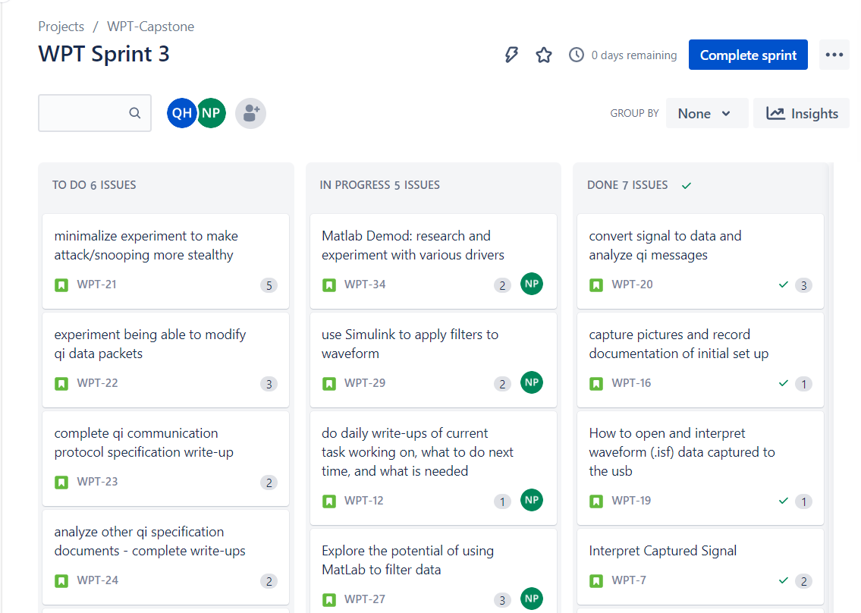
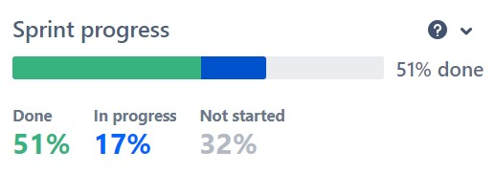
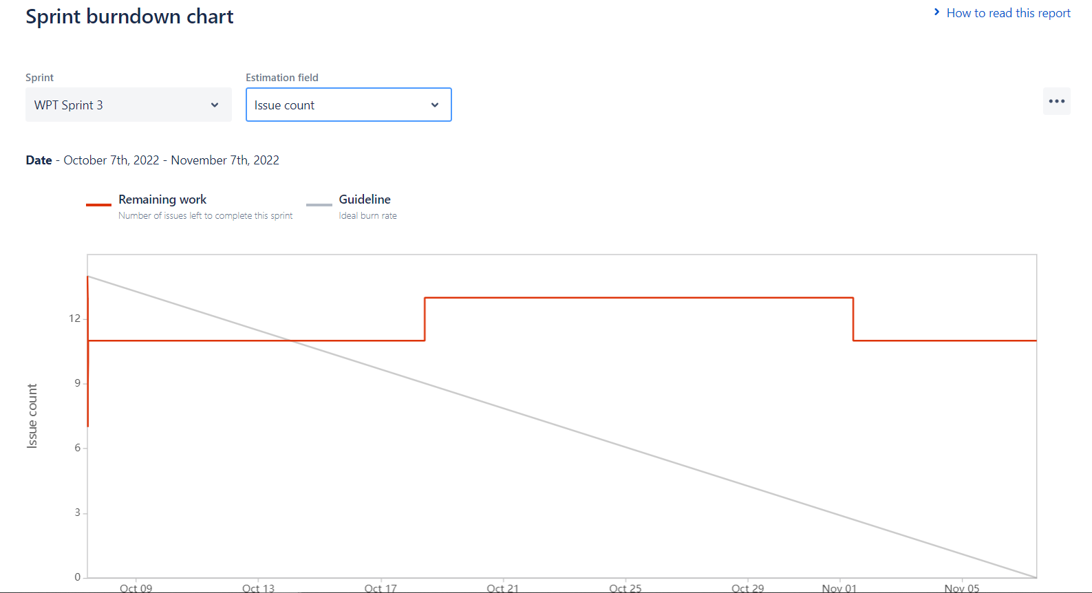
Sprint Organization
Utilized Jira Software to track the sprint process

Slide 7
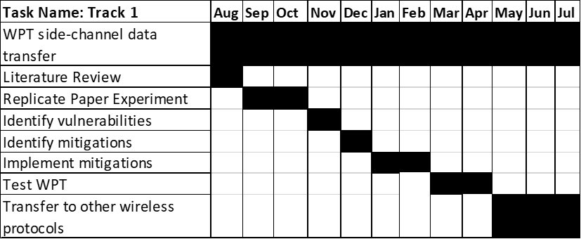
Research Timeline
Sprint 1
Conducting research about WPT and related technologies
Acquired necessary materials to replicate experiments
Sprint 2
Generated code to achieve demodulation
Completed hijacking proof of concept
Sprint 3
Researched Qi packet signatures
Gained voltage signatures
Researched WPT interaction with operating system
Sprint 4
Researched and simulated software encryption
Explored alternative defensive mitigations

Slide 8
Motivation
Wireless Power Transfer has become an industry standard being incorporated into more and more areas of technology
Personal Electronics, Healthcare Devices, Electric Vehicles
Exploit techniques and results found in this experiment can potentially be generalized
This research will create a foundation for further experimentation and TTP development
Findings expanded to other wireless non-networked point-to-point connections

Slide 9
Problem Statement
IDENTIFY
Vulnerabilities
How to exploit
How to defend
APPLY
Proof of concept – hijacking
Proof of concept – eavesdropping
Interpretation of results
EXPAND
Provide research to NRO
Observe various side channel-attacks
Create security mitigations – Software Based Encryption
Expand to larger technologies

Slide 10
Key Accomplishments to Date
Replicated Experiment
Wireless Charging Power Side-Channel Attacks
Demonstrated Injection
Demonstrated Snooping
Developed Demodulation Program
Researched various aspects of WPT and related attacks/mitigation
Encryption
Signature Analysis
OS Interactions

Slide 11
Summary of Related Work
CoDoC: A Novel Attack for Wireless Rechargeable Sensor Networks through Denial of Charge
WPT networks susceptible to Denial of Charge (DoC) attacks
Can disrupt network reliability, network functionality, and possibly trigger event loss
Safe and Secure Wireless Power Transfer Networks: Challenges and Opportunities in RF-Based Systems
Handful of attacks – safety, charging, interference, spoofing, software, and monitoring attacks
Countermeasures should be implemented as small and energy-efficient protocols to ensure safe and secure energy transfer
Wireless Charging Power Side-Channel Attacks
the amount of current being drawn from the charger can be used to determine which applications are being used by the mobile device
Shows weaknesses of such attacks; ex: the longer a device is being used, the less accurate the estimate is

Slide 12
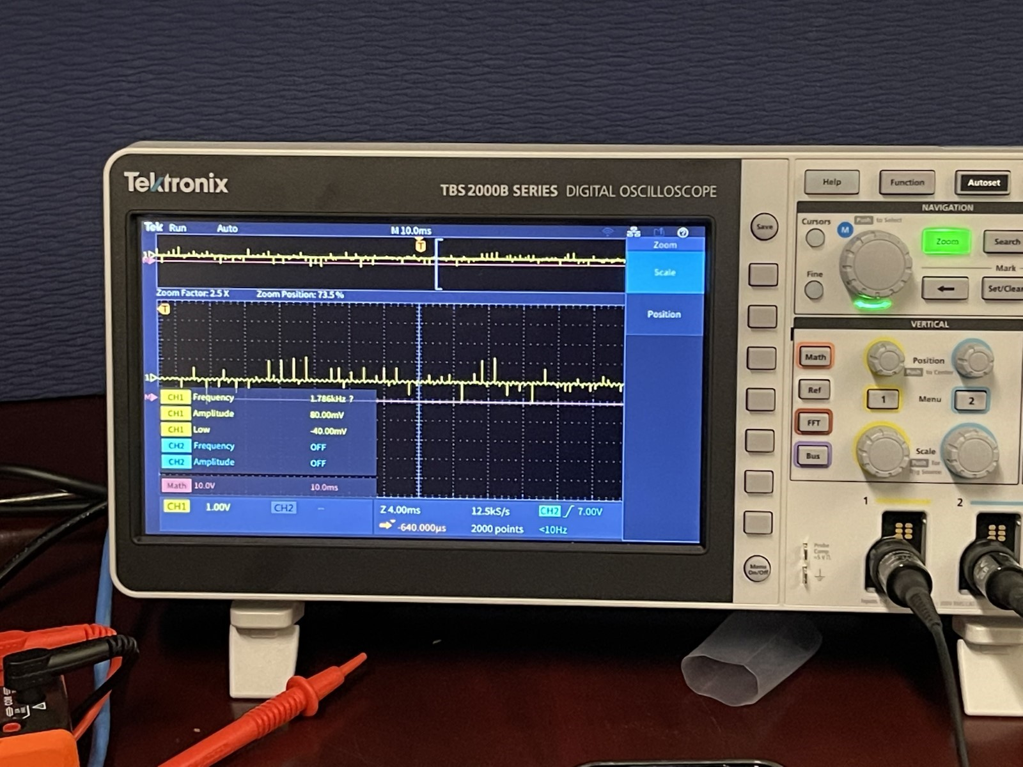
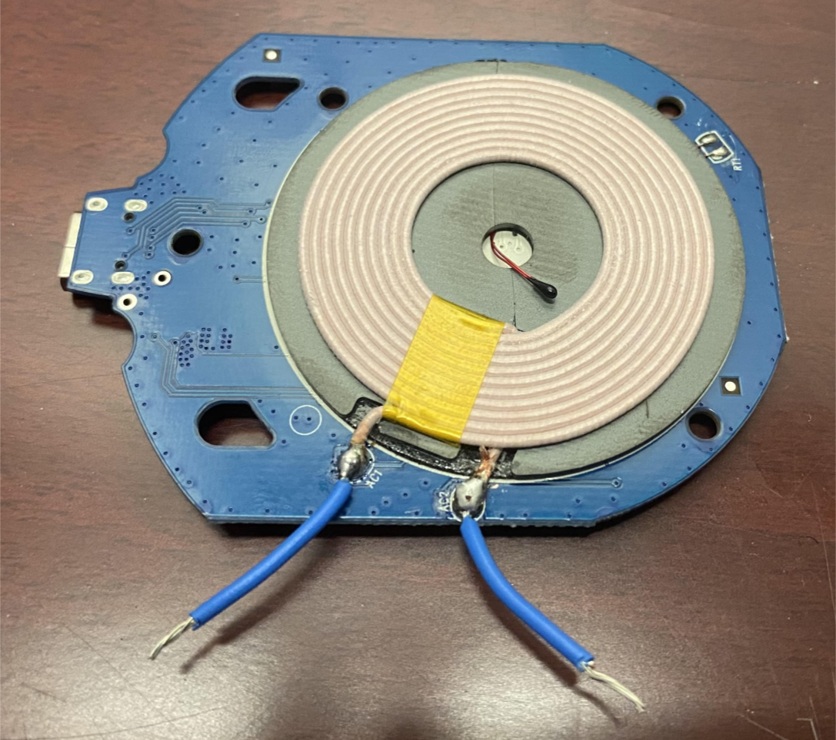
Day 1 Methodology
Taking inventory of all equipment
created a list of needed equipment using the Security of Qi Standards research paper and experiment as a guide
Soldered leads onto the stripped coils from the wireless chargers
begin taking initial reads of the Qi communications
Focused on analyzing the readouts from the oscilloscope to attempt to demodulate the bits and determine the communication process of Qi standard adhering equipment
Challenges in the form of demodulation - initially unable to extrapolate exact bits from the oscilloscope

Slide 13
Demodulation - Methods
MatLab
Strategy: Read waveform data into MatLab and use premade code for demodulation filters
Problems: Familiarity with tool, getting data into Simulink
Oscilliscope Filters / TekScope
Strategy: Use filters directly on oscilloscope /within TekScope suite
Problems: No license for bus features, no bus for Qi demodulation
Python
Strategy: Read captured waveform data from stored file to apply demodulation filters
Problems: One packet at a time – limited capture size

Slide 14
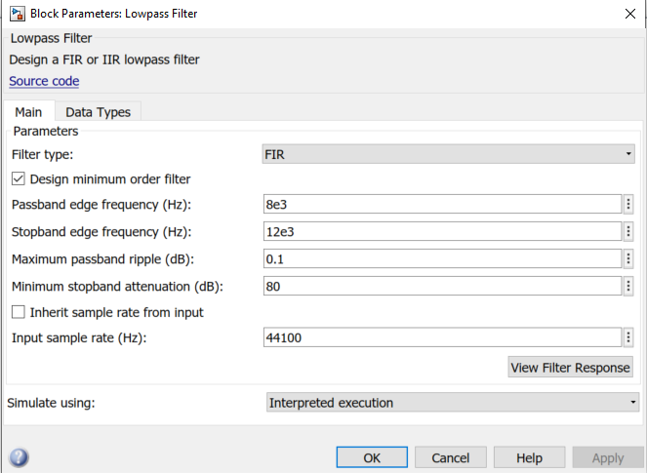
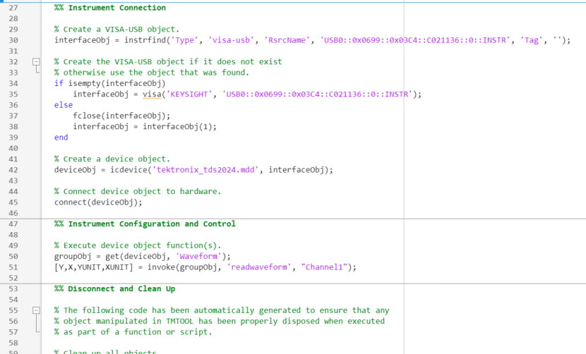
MatLab Demodulation
MATLAB object driver to read waveform/import data
Simulink to apply lowpass filter

Slide 15
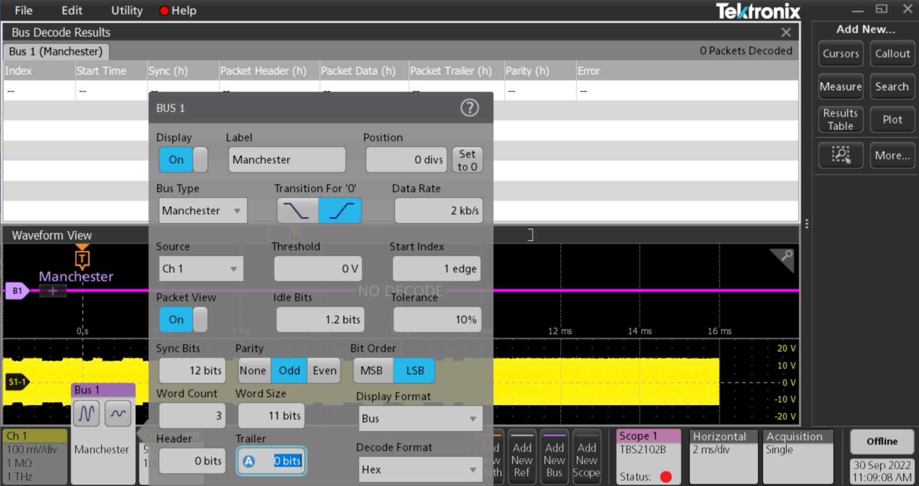
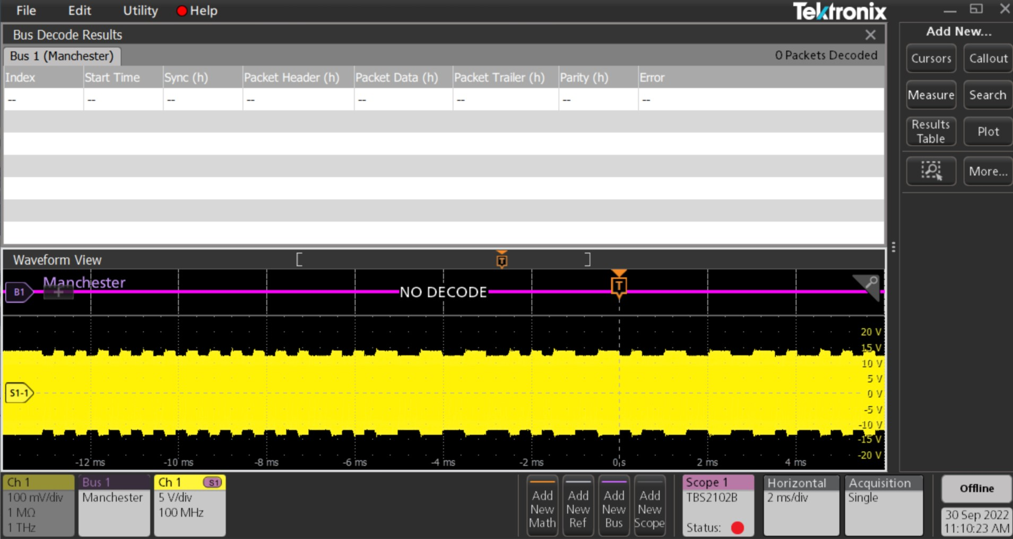
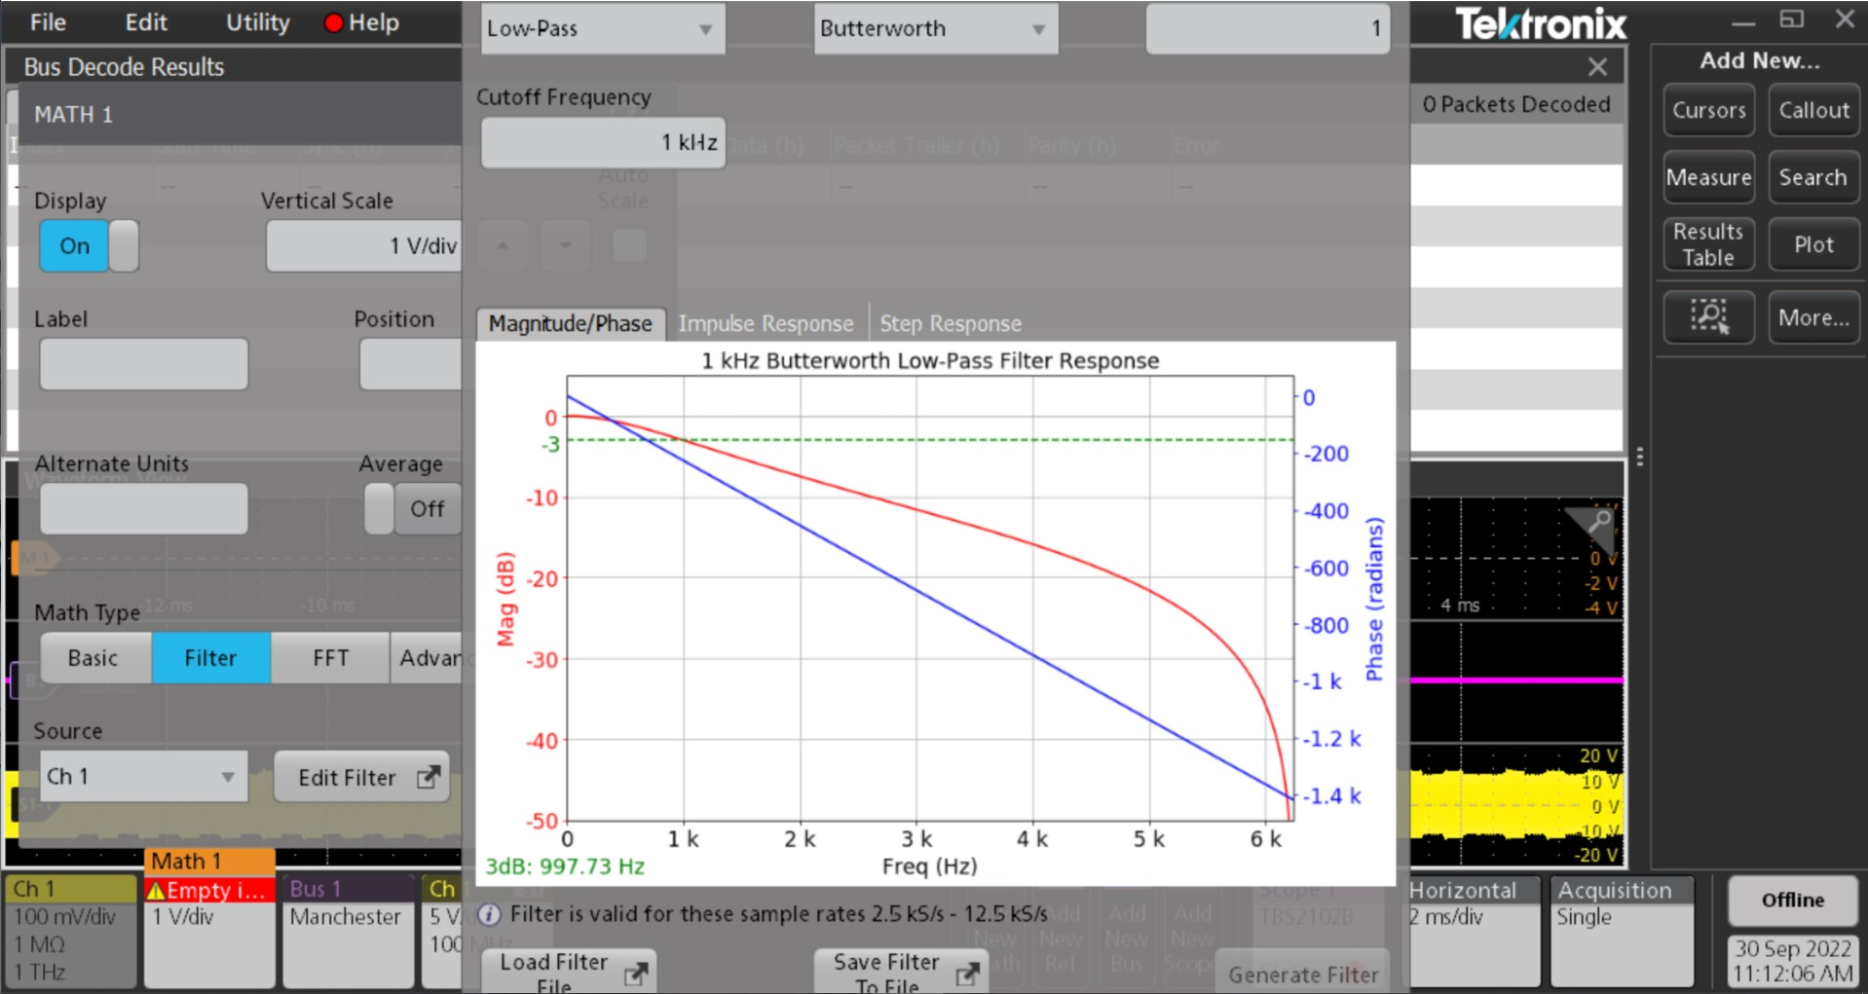
TekScope Demodulation
TekScope software use:
Manchester Bus
Low pass filter
A lot of other attempts
Filters
Busses
Math

Slide 16
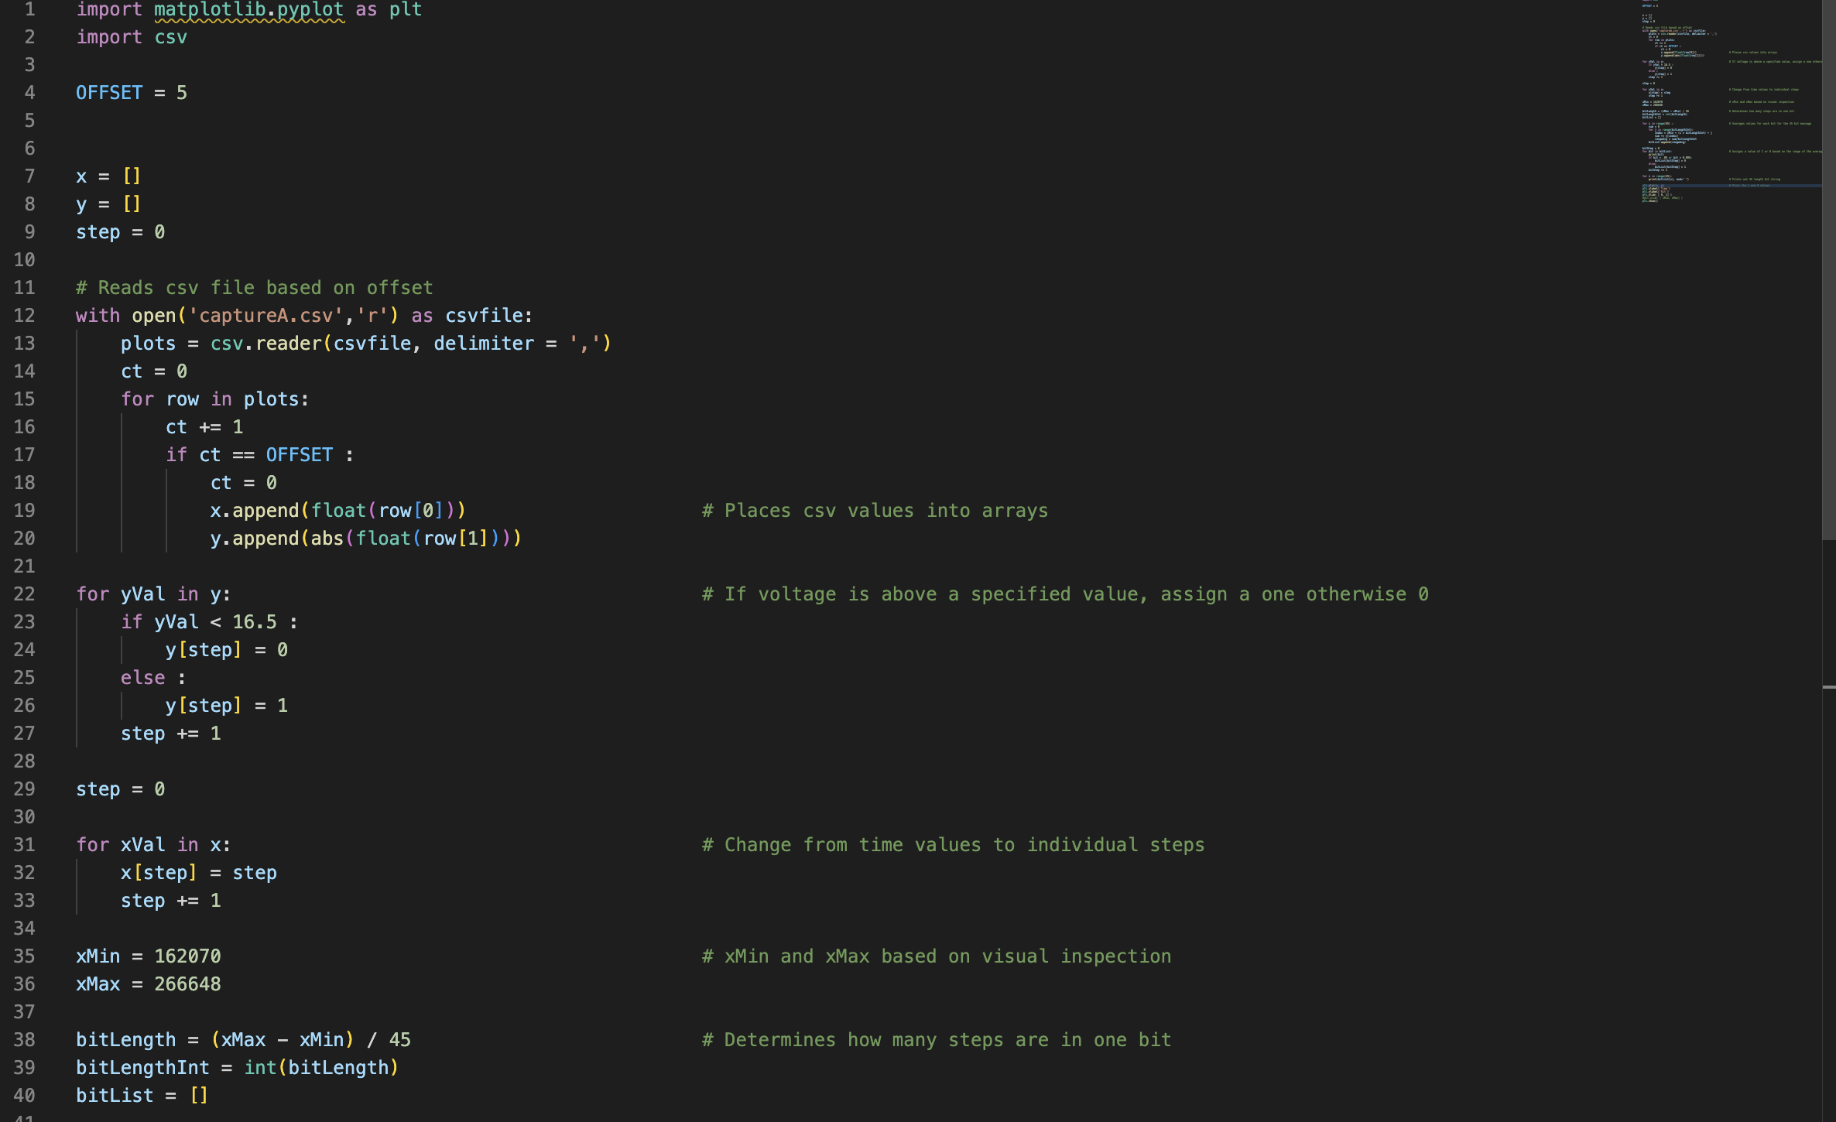
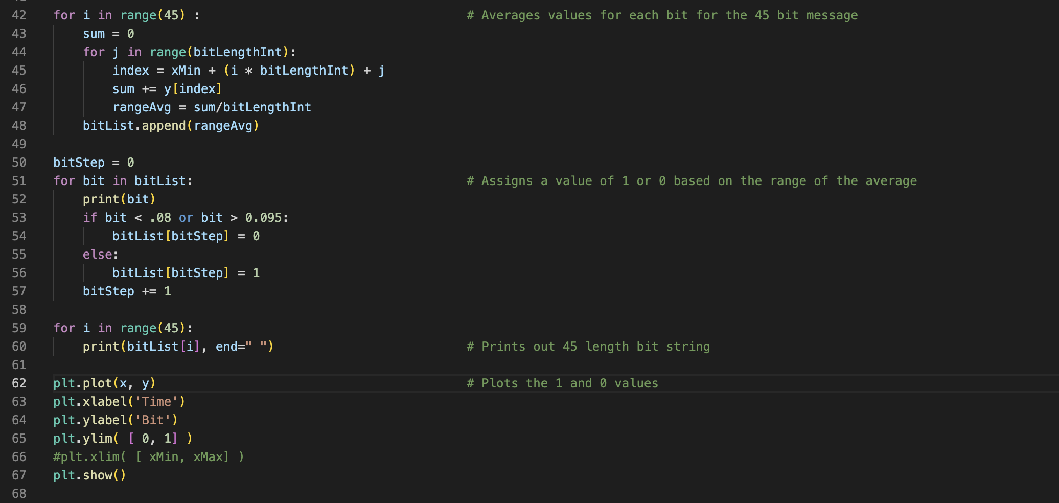
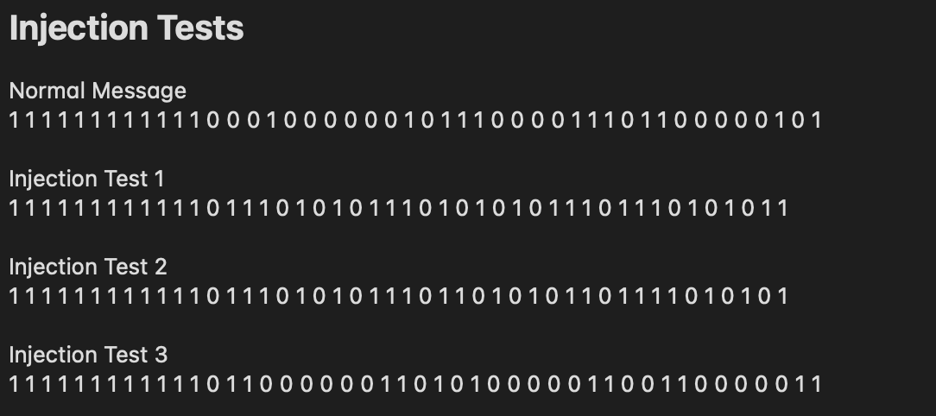
Python Demodulation

Slide 17
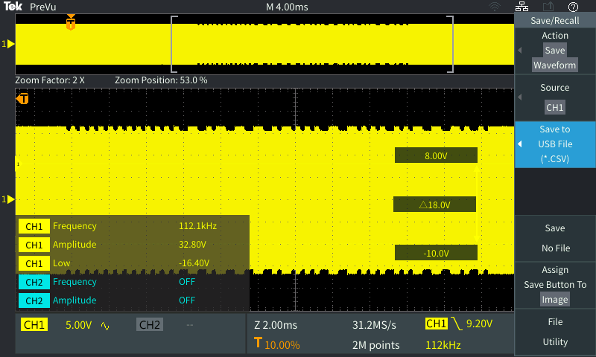
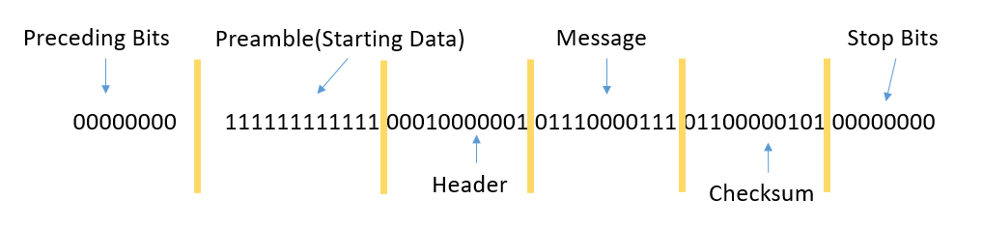
Packet Interception
Captured Signal
Captured Signal Demodulated
Signal Strength Status Update 1

Slide 18
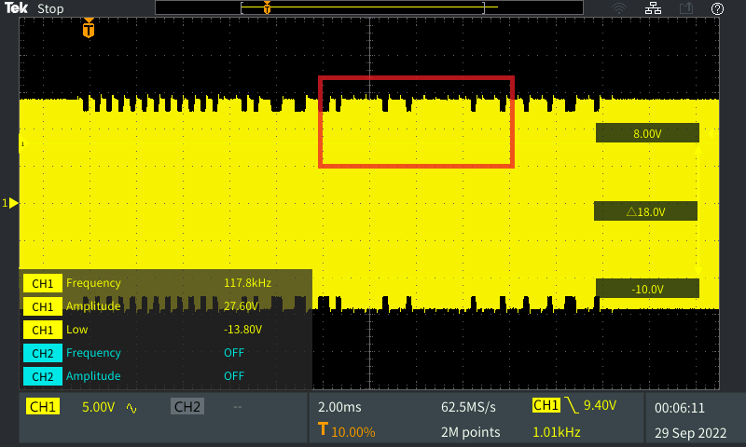
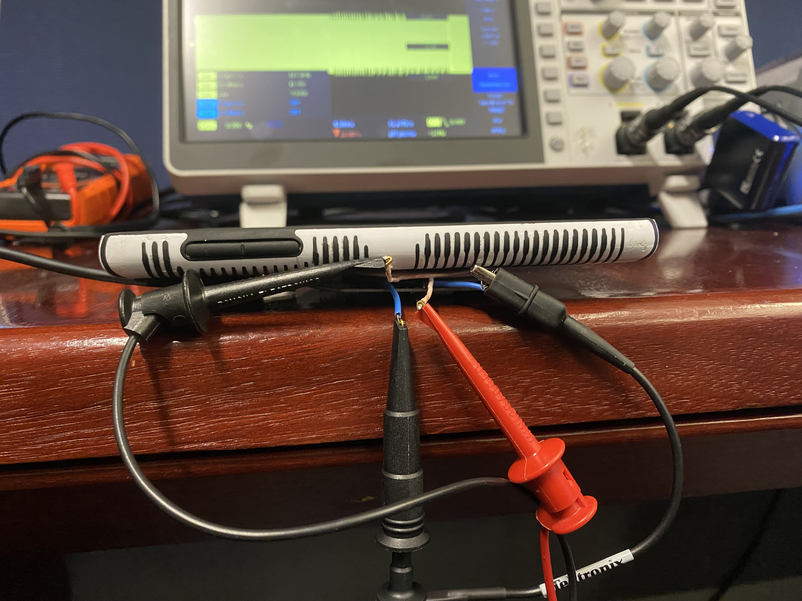
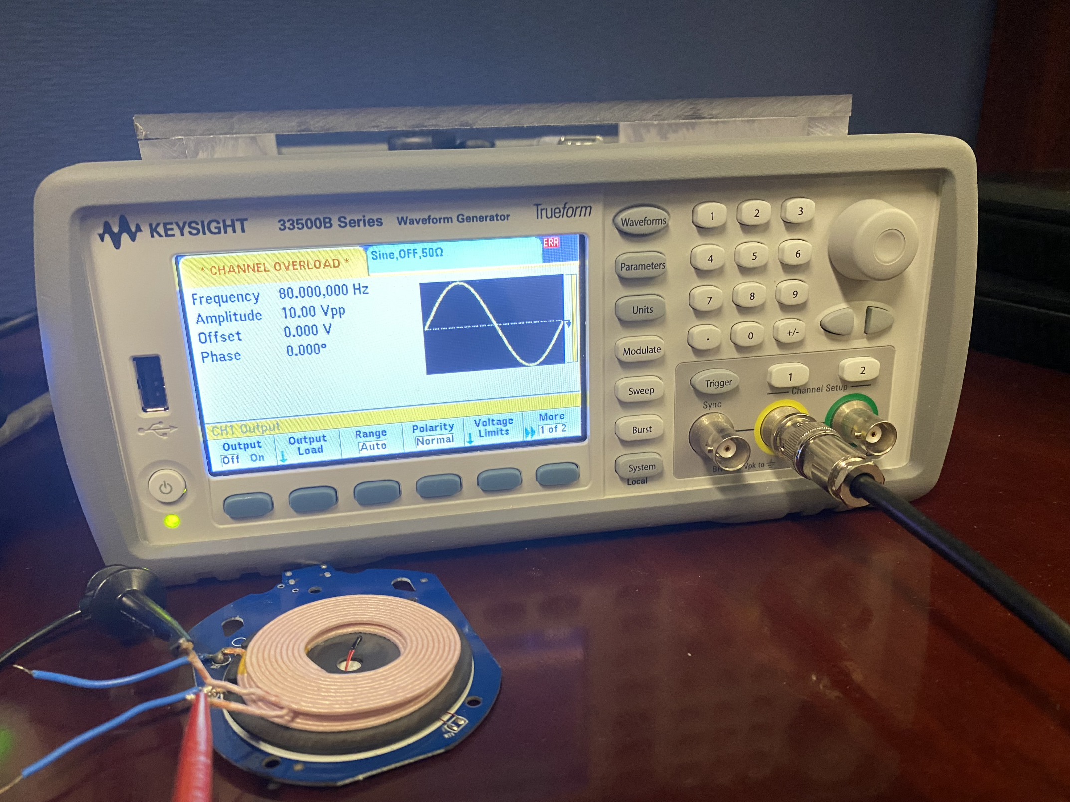
Packet Injection
Crafted Waveform Signal
Frequency: 80kHz
Amplitude: 10Vpp
Offset: 0V
Phase: 0V
Injection Test 1
1 1 1 1 1 1 1 1 1 1 1 1 0 1 1 1 0 1 0 1 0 1 1 1 0 1 0 1 0 1 0 1 1 1 0 1 1 1 0 1 0 1 0 1 1
Channel Overload
(Magnetic Signal Interference)

Slide 19
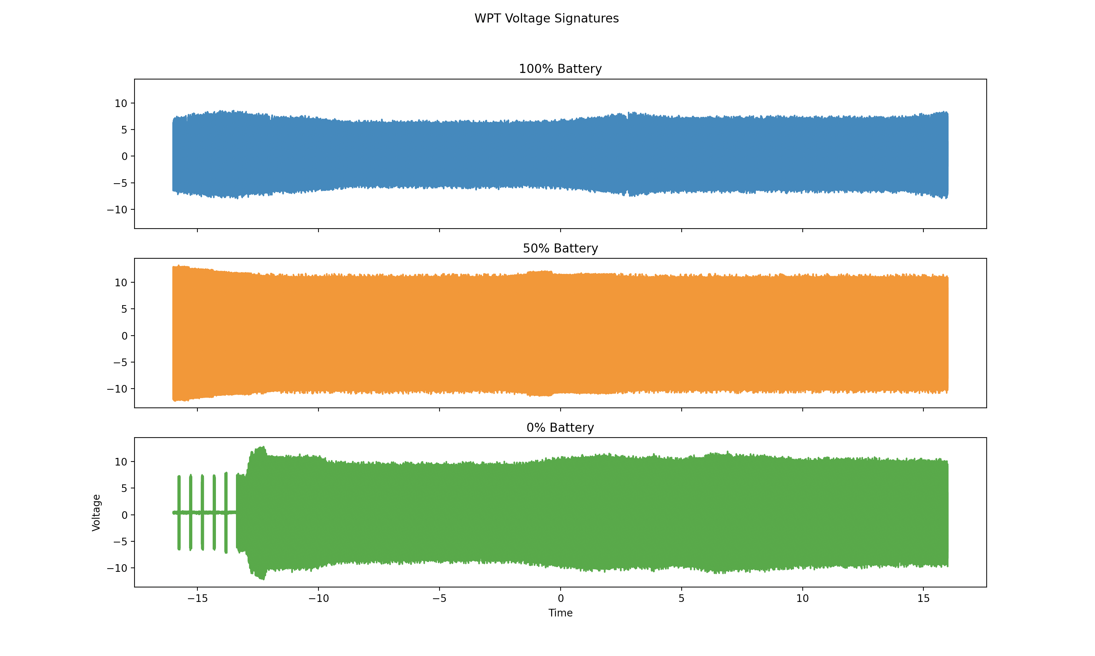
Signature Analysis
Voltage readings taken at three different battery percentage values (100%, 50%, 0%)
.csv files loaded into python plotting program
Voltage differences noticed in 100% battery charging
Individual samples (not averages)

Slide 20

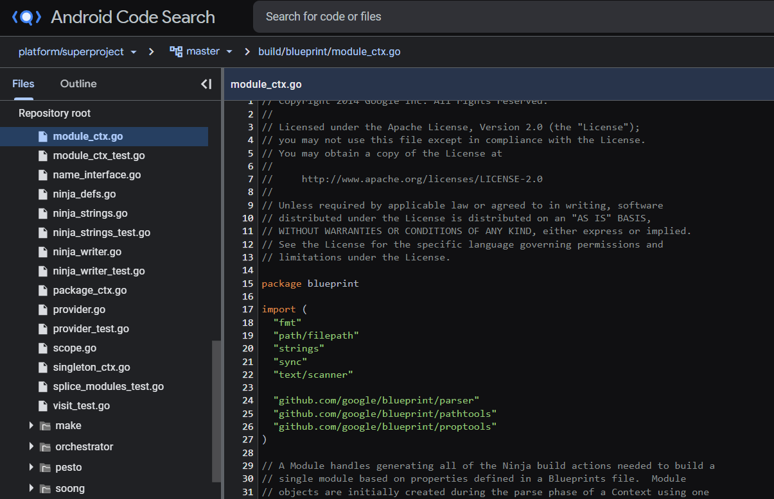
Android OS
Android Open Source Project
Mirror of existing build – contains previous builds
Android Code Search
Tool – allow developers to view Android source code

Slide 21

Android OS
Viewed and analyzed OS source code
Searching for how the Android operating system interacts and interprets, if at all, any incoming Qi communications.
No prior publications found – researched from ground up
Cumulative Time Spent: ~32 Hours

Slide 22
Android OS
Findings:
No evidence to suggest that the OS controls the process overtly (besides normal battery function and recognizing that the phone is receiving power).
We do believe that our findings give us enough of a confirmation to conclude that this vector is not a real possibility for this group to pursue.
OS is unlikely to be anything more than severely limited.
Best vector for attack using this technology will remain as voltage analysis (side channel attacks using voltage) and as denial-of-service style attacks using injection methods.

Slide 23
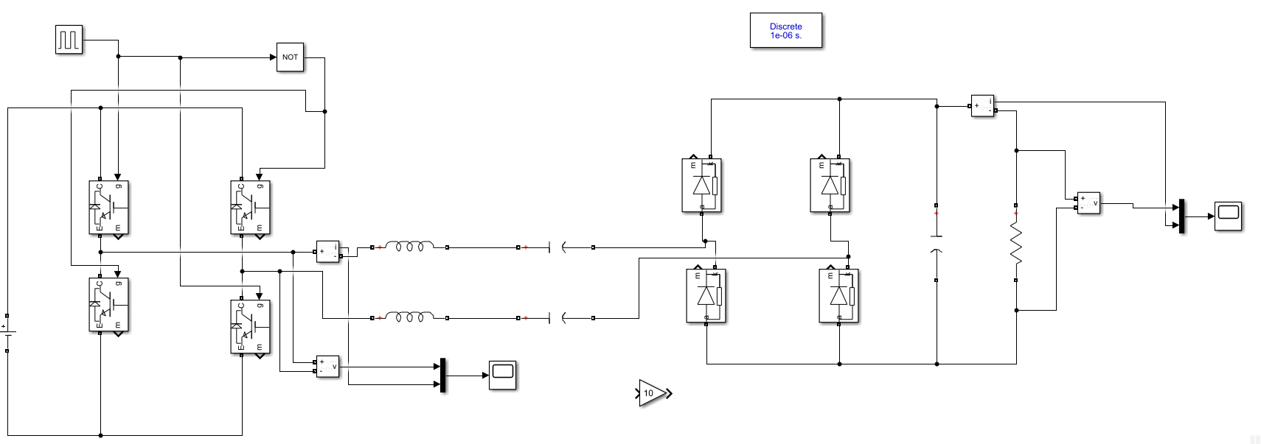
Charging Simulation

Slide 24
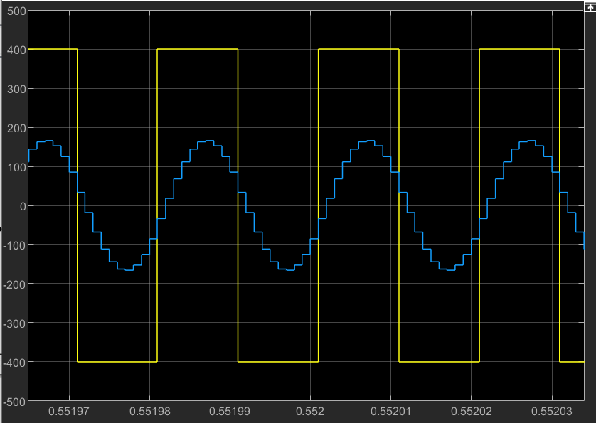
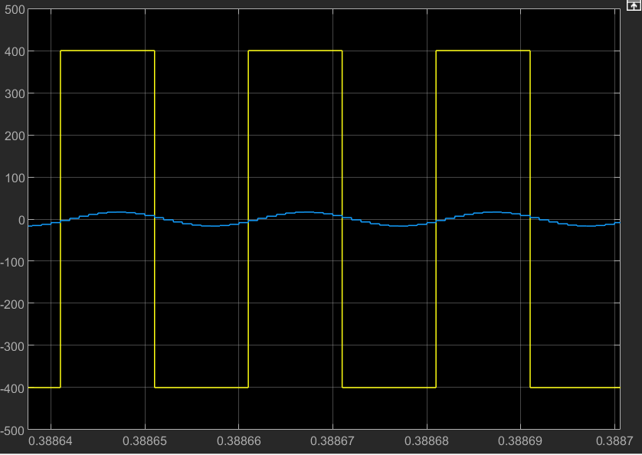
Charging Simulation

Slide 25
Eavesdropping Defense - Noise
Noise makes power signature less readable
Signature accuracy drops from 91.2% to 44.4%
Can be achieved with waveform generator and adversarial coil

Slide 26
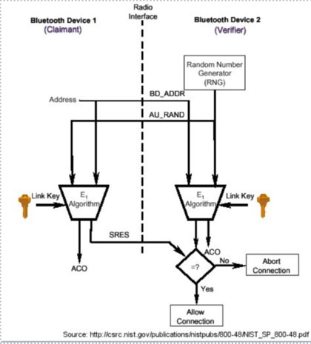
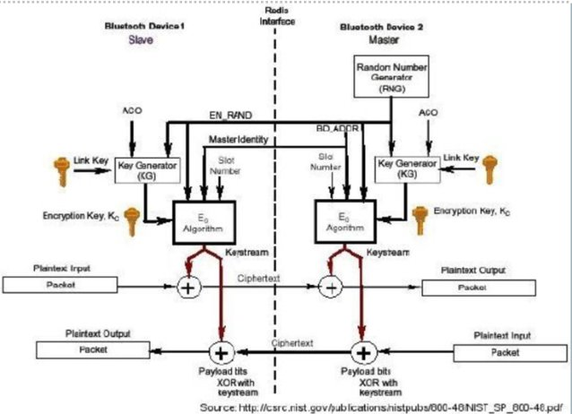
Eavesdropping Defense - Encryption
Using Bluetooth as a model
Bluetooth implements the following systems:

Slide 27
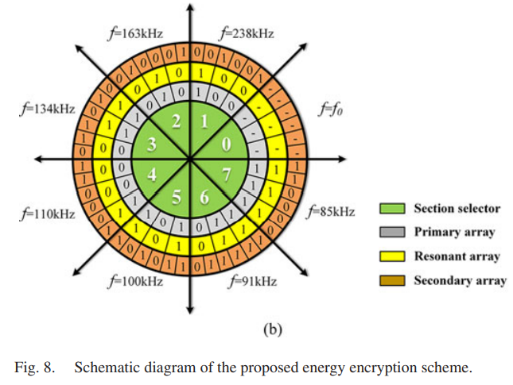
Software Based Encryption

Slide 28
Results Summary + Discussion
Produced Packet Interception and Decoding for Snooping Purposes
Produced Packet Injection with Adversary Binary
Android OS
No further research suggested, rule out IOS
Software Based – Authentication
Basic key exchange created by transmitting node
Software Based – Encryption
Chaotically regulated encrypted switching frequency
Signature Analysis
Identified discernable variances in data gathered at different thresholds
Need to work on quantifiable differences

Slide 29
Spring Semester
Packet Sniffer Acquired
Expand Snooping Research
Differentiate applications – based on power usage
Extract data from communications
In depth packet analysis (identifiers, etc)
Extract user input from receiver
Customized Injection Development
Craft Hardware
Develop Signal
Experiment with timing
Soft Encryption Development

Slide 30
Future Work
Modification of Qi packets
Qi communication packets are interpreted on the receiver device, modification of the data component within the Negotiation Phase may allow code execution or data exfiltration on the receiver device
Applications with laser-based point-to-point communication
Non-networked systems
Development of Qi Protection Mechanisms
Hardware or Software based cryptography
Injection/packet modification detection

Slide 31

Questions
31

